Slide 1


U20CSPR02- MINI PROJECT
BATCH NO: G 14
DOMAIN: DATA SCIENCE AND MACHINE LEARNING
PROJECT TITLE : WILDFIRE PREDICTION USING DATA SCIENCE AND
MACHINE LEARNING
S. No. | Register number | Name of the Student
1 | U22CS071 | B. MANIKANTA REDDY
2 | U22CS035 | A. NARENDRA
3 | U22CS067 | B.VISHWAS REDDY
4 | U22CS080 | BANTI KUMARI
GUIDED BY: G. NIVETHA SRI

Slide 2
CONTENTS
Abstract
Objective
Block Diagram
Algorithm Explained
Program Coding
Demo Model
Output & Results
Conclusion

Slide 3

Abstract:
Wildfires cause severe ecological, economic, and social impacts, making early prediction essential. Data science and machine learning provide effective tools to analyze weather, vegetation, and historical fire data for identifying high-risk areas. This study applies predictive models such as Random Forest and Neural Networks to improve wildfire forecasting accuracy. The findings aim to support early warning systems, resource management, and disaster mitigation.

Slide 4
Objective:
● Develop ML model to predict wildfire occurrences.
● Classify fire-prone vs non-fire-prone areas.
●Predict Fire Weather Index (FWI) using regression.
●Use MongoDB for data storage.
●Perform Exploratory Data Analysis for insights

Slide 5
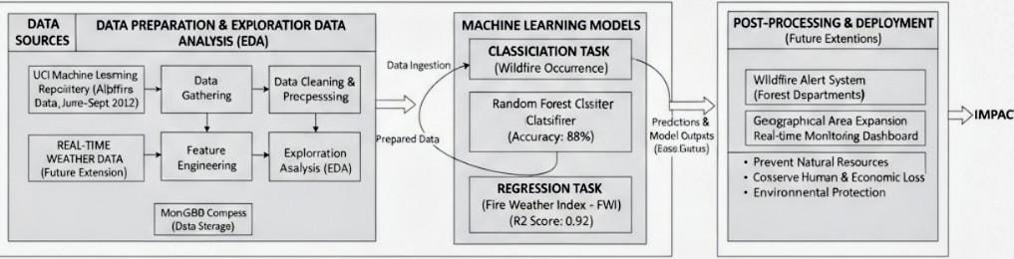
Block Diagram:

Slide 6
Algorithm Explained:
Data Collection: Gather wildfire and weather data from the UCI dataset (temperature, humidity, wind speed, rainfall, etc.).
Data Preprocessing: Clean data, handle missing values, normalize features, and split into training, validation, and test sets.
Model Building Classification: Predict fire/no fire using models like Random Forest, Decision Tree, Logistic Regression, KNN.
Regression: Predict Fire Weather Index (FWI) using Random Forest Regressor, Linear
Regression,SVR.

Slide 7
Model Optimization: Apply hyperparameter tuning and cross-validation to improve performance.
Evaluation: Measure accuracy, precision, recall (for classification) and R², MAE, RMSE (for regression).
Prediction Output: Predict wildfire risk and FWI, store results in MongoDB, and visualize outcomes.

Slide 8
Program Coding:
Language & Tools: Python, Pandas, NumPy, Scikit-learn, Matplotlib, Seaborn
Algorithm Used: Random Forest / SVM / XGBoost
Dataset Features: Temperature, Humidity, Wind Speed, Rainfall, NDVI, Fire Weather Index
Steps in Coding:
Import libraries
Load dataset (wildfire_data.csv)
Preprocess data (handle missing values, split features & labels)
Train model using Random Forest Classifier
Predict and evaluate with accuracy, classification report, confusion matrix
Output: Predicts if wildfire will occur (1) or not (0) based on input parameters.

Slide 9
Demo Model:
Input: Weather data — temperature, humidity, wind speed, rainfall, etc.
Preprocessing: Clean and normalize the data.
Model Training: Use Random Forest Classifier to predict fire occurrence and Random Forest Regressor to predict the Fire Weather Index (FWI).
Prediction: The model outputs whether a wildfire is likely or not, and the FWI value.
Storage & Display: Results are saved in MongoDB and shown through graphs or a simple web app

Slide 10
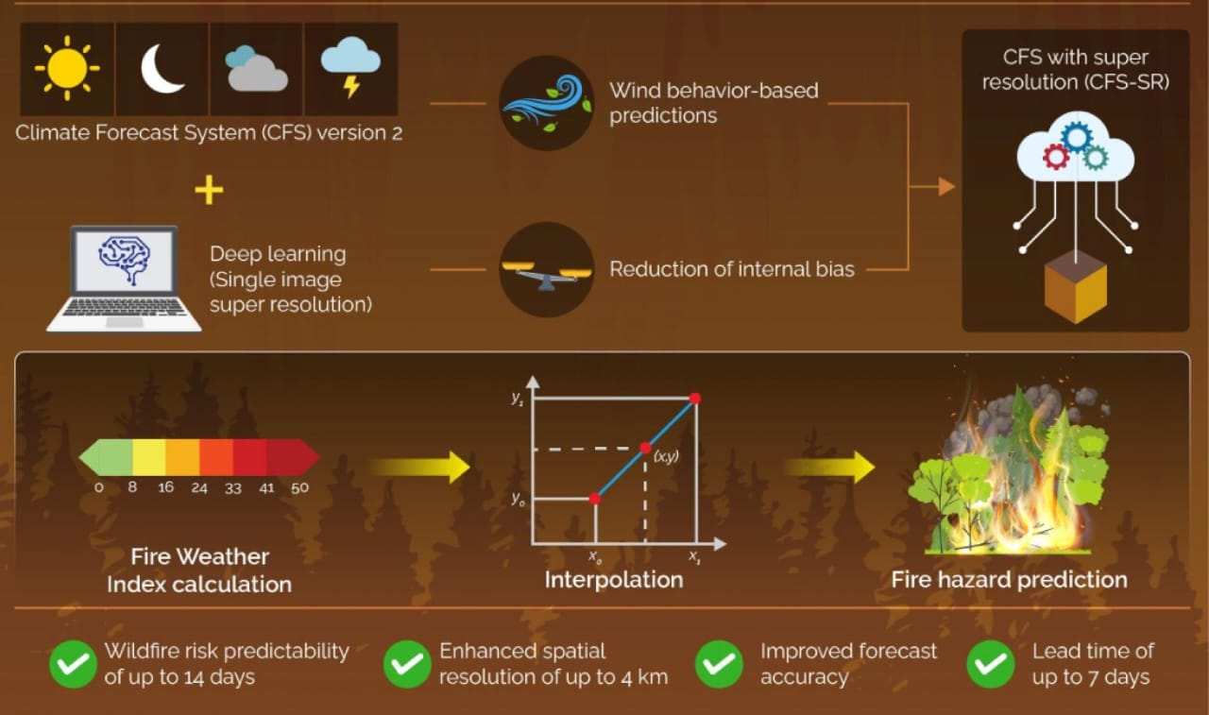

Slide 11
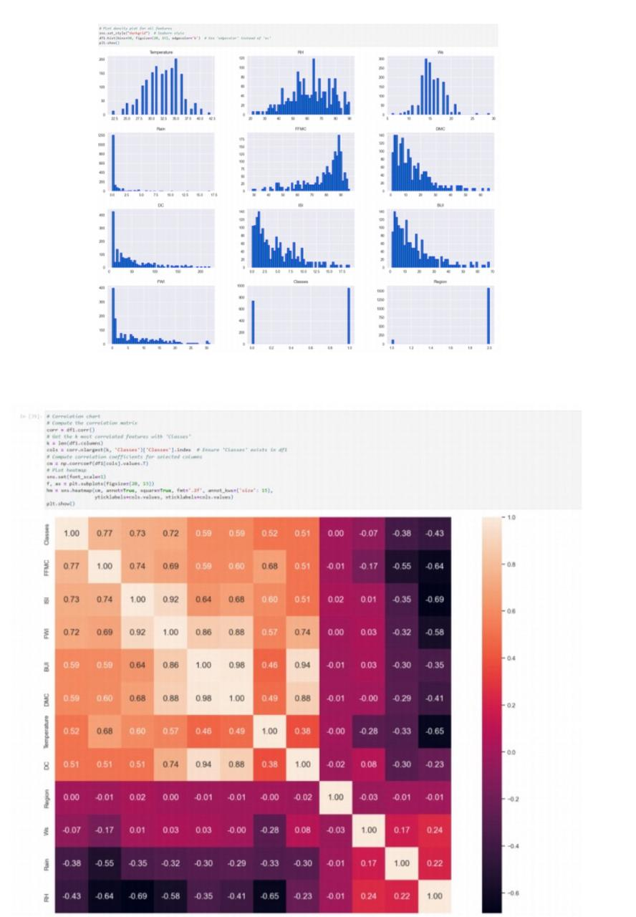
Output & Results:
EDA:

Slide 12
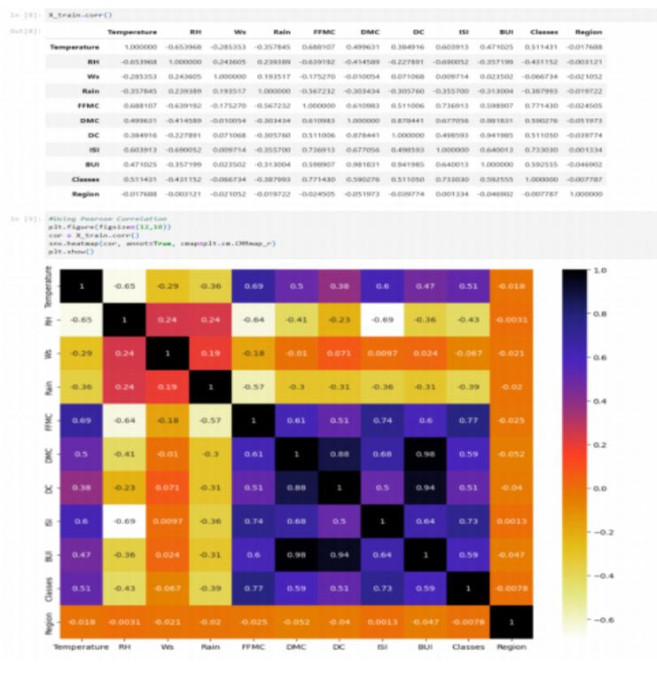
MODEL:

Slide 13
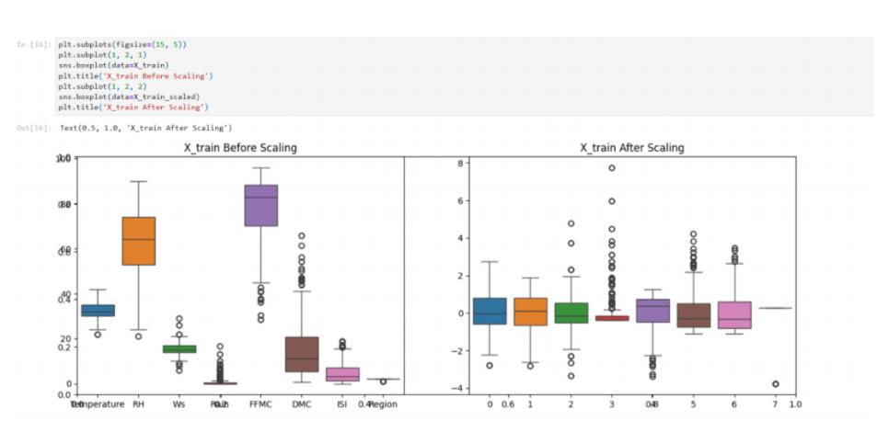

Slide 14
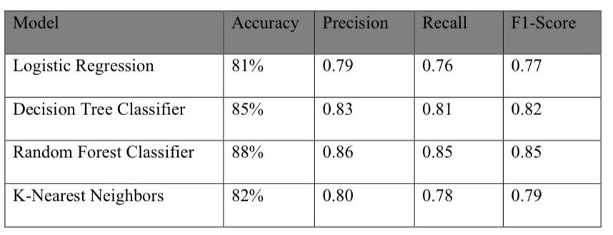
Classification Model Comparison:
The fire occurrence prediction models analyzed meteorological conditions for makingtheir forecasts.The performance metrics for the models are outlined below:
Analysis:
The Random Forest Classifier demonstrated remarkable proficiency in managing non-linear relationships, achieving an accuracy rate of 88%.
2. The Decision Tree Classifier exhibited performance characteristics akin to those of theRandom Forest, primarily due to its reduced likelihood of overfitting.

Slide 15
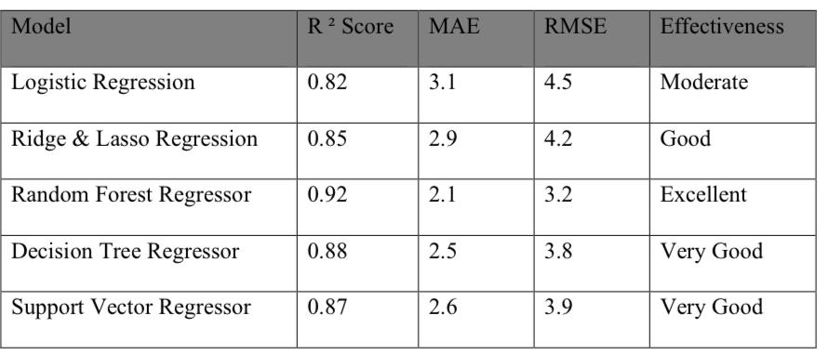
Regression Model Comparison:
The Fire Weather Index (FWI) received predictions through usage of regression models. Below is a performance comparison:
Analysis:
1. Random Forest Regressor demonstrated the most predictive ability by reaching an R² value of 0.92
2. Decision Tree Regressor showed good performance although it proved slightly weak to the data.
3. The R² score of Linear Regression proved to be the lowest indicating that wildfire prediction needs to use non-linear modeling methods.

Slide 16
Conclusion:
The project successfully predicts wildfires using machine learning and weather data. The Random Forest Classifier achieved 88% accuracy, and the Random Forest Regressor reached an R² score of 0.92. It proves that data science can help in early wildfire detection and disaster prevention effectively.

Slide 17
THANK YOU

